Slide 1
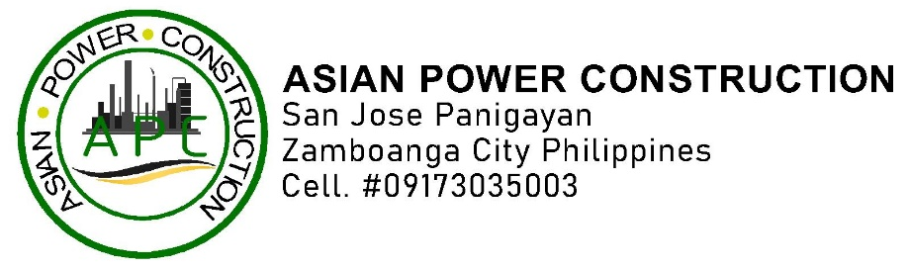
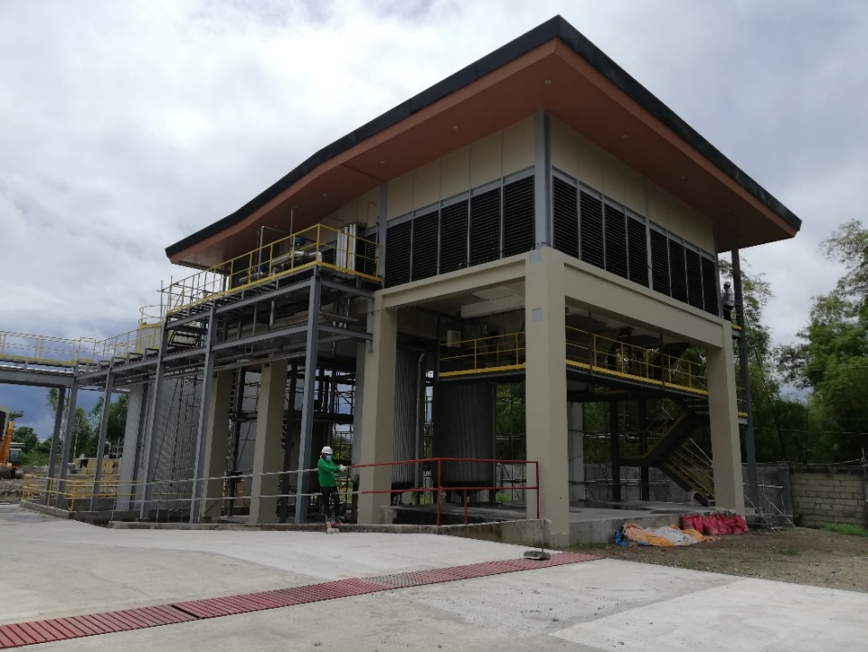
COMPANY
DEVELOPING REALITY
PROFILE

Slide 2
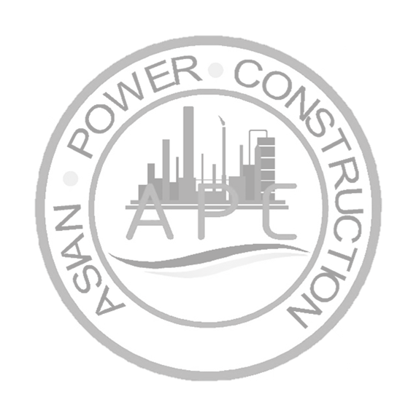
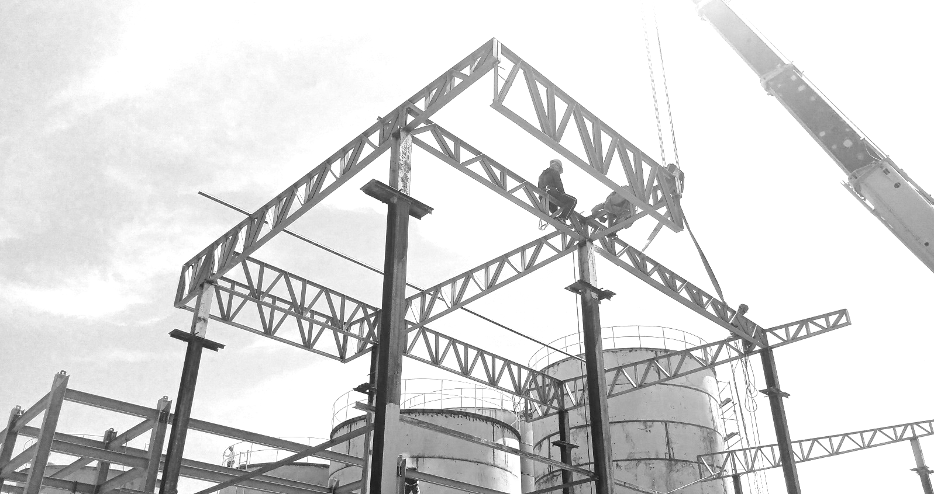
At Asian Power Construction Company, we take pride in being a trusted general contractor since our establishment on February 13, 2001. We provide comprehensive construction services, including site analysis, feasibility studies, preliminary design assessments, and permit/zoning applications.
Our expertise spans a wide range of projects, including industrial, distribution, manufacturing, office, retail, recreational, healthcare, and commercial developments. Based in San Jose, Panigayan, Zamboanga City, we are committed to delivering high quality construction solutions tailored to our clients' needs.
As an industry leader, we are dedicated to delivering value-driven construction services by fostering strong partnerships with our clients. We are committed to exceeding expectations, building long-term relationships, and ensuring project success through exceptional performance from every member of our team.

Slide 3
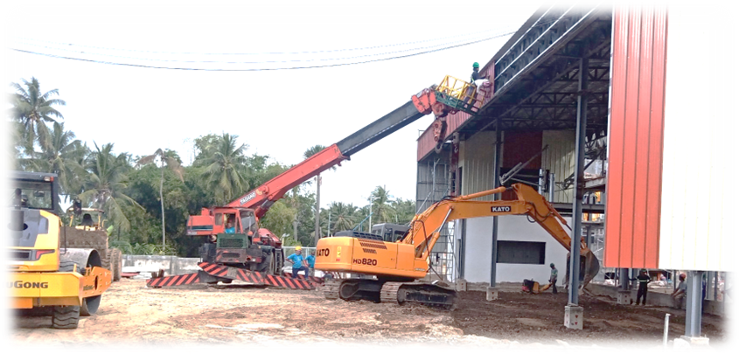

Our Vision
Our Mission
To be a Construction Company in Global Market, to become the customers most preferred choice by attaining excellence in quality and timely completed value-added projects.
To provide the highest level of service in construction industry while offering superior craftsmanship to every project we Handle.
Company S-Core Values
Safety
Leadership
Passion
Teamwork
Honesty and Integrity
Attitude
Commitment
Respect

Slide 4
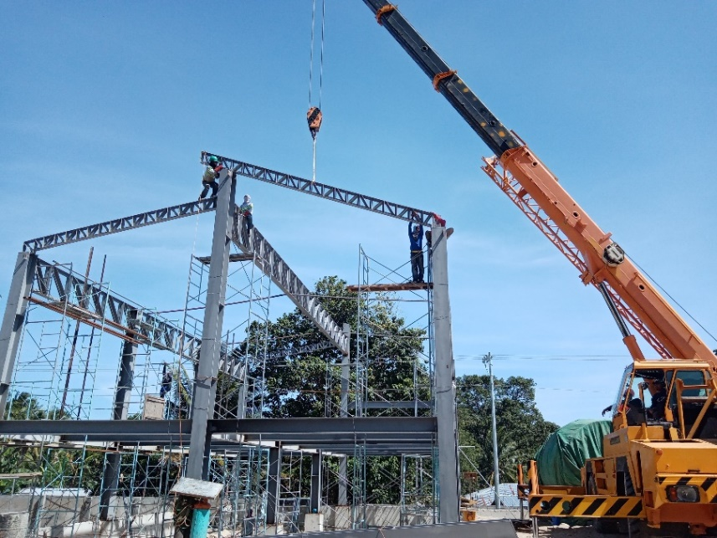
General Engineering Services
Design
Consult
Construction
What we offer?
General Engineering
Roads
Highways
Bridges
Horizontal Structure
Architectural
General Building
Building & Industrial plant
General Mechanical
Piping works
Fabrication of Tank & Vessel
Cladding works
w/ specialty in Mechanical works
Other Services
Trucking and Heavy Equipment Services
Retailer-Hardware-Construction Supplies
Retailer-Office and School Supplies

Slide 5
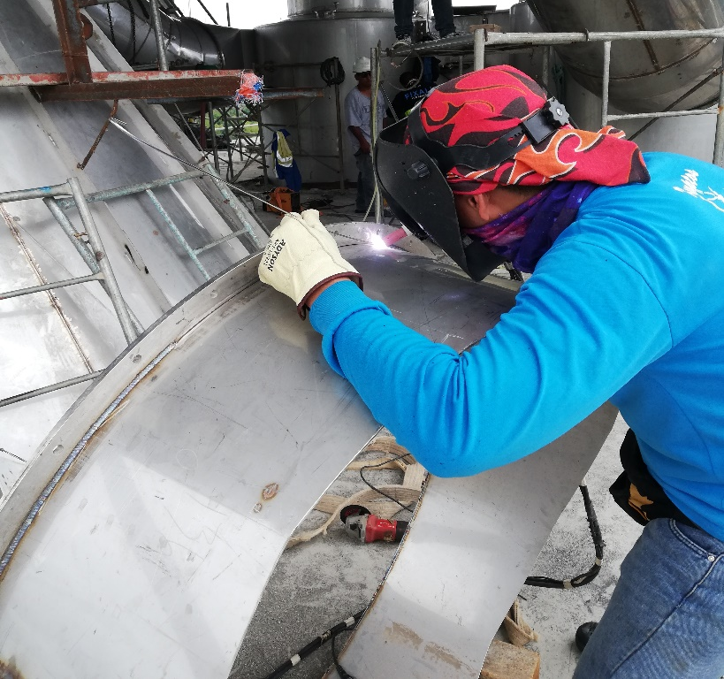
Quality & Safety
Asian Power Construction understands the importance of providing quality, safe and clean services to our client is the vital part of being a successful building services provider.

Slide 6
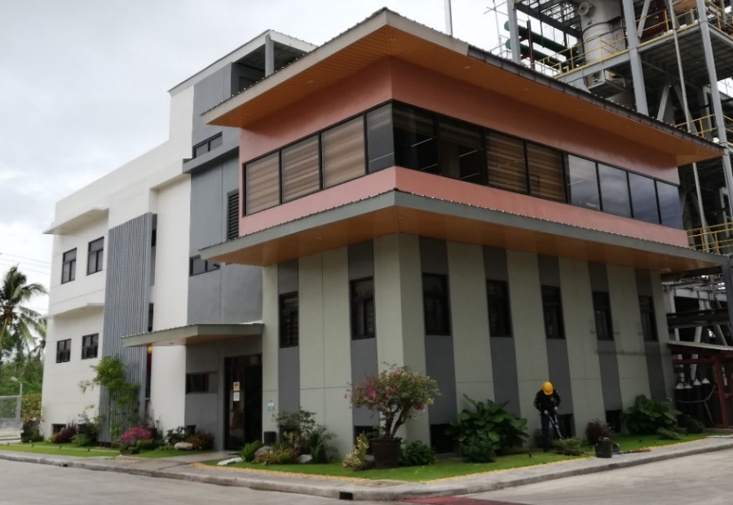
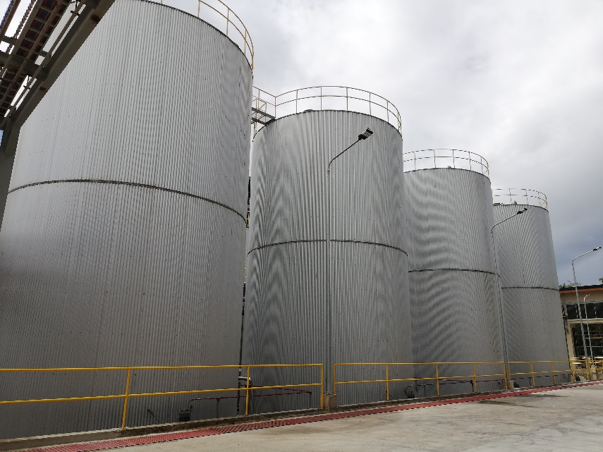
Previous Projects
Asian Power Construction provides high quality technical solutions reached the requirements of the Projects.
LABORATORY BLDG. – ALL NATURAL COCO PRODUCTS
Location: ANC Compound Bacong, Negros Oriental
Project Duration:
Scope of Works:
Site Preparation
Structural and Architectural Construction
Laboratory Fit-Out
Testing, Commissioning, and Handover
MEP Installation (Mechanical, Electrical, Plumbing)
CLADDING OF STORAGE TANK - ALL NATURAL COCO PRODUCTS
Location: ANC Compound Bacong, Negros Oriental
Project Duration:
Scope of Works:
Surface Preparation
Insulation Installation
Cladding Fabrication and Supply
Sealing and Waterproofing
Install Supports and Accessories.

Slide 7
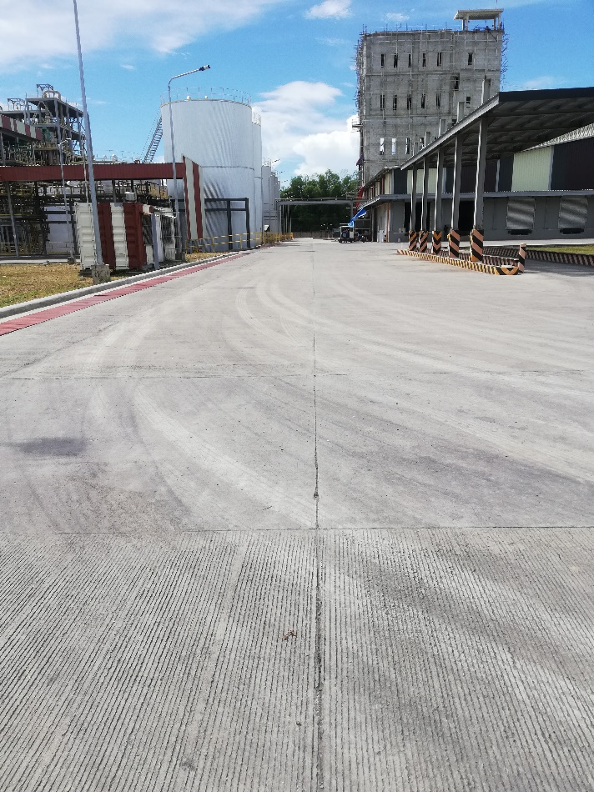

Previous Projects
Asian Power Construction provides high quality technical solutions reached the requirements of the Projects.
ANC COMPOUND-ROAD CONCRETING - ALL NATURAL COCO PRODUCTS
Location: ANC Compound Bacong, Negros Oriental
Project Duration:
Scope of Works:
Site Clearing and Excavation
Subgrade Preparation and Compaction
Formwork and Reinforcement Installation
Concrete Placement and Finishing
Curing and Joint Cutting
GLYCERIN BLDG. - ALL NATURAL COCO PRODUCTS
Location: ANC Compound Bacong, Negros Oriental
Project Duration:
Scope of Works:
Site Preparation
Structural and Architectural Construction
Testing, Commissioning, and
Handover
MEP Installation (Mechanical, Electrical, Plumbing)

Slide 8
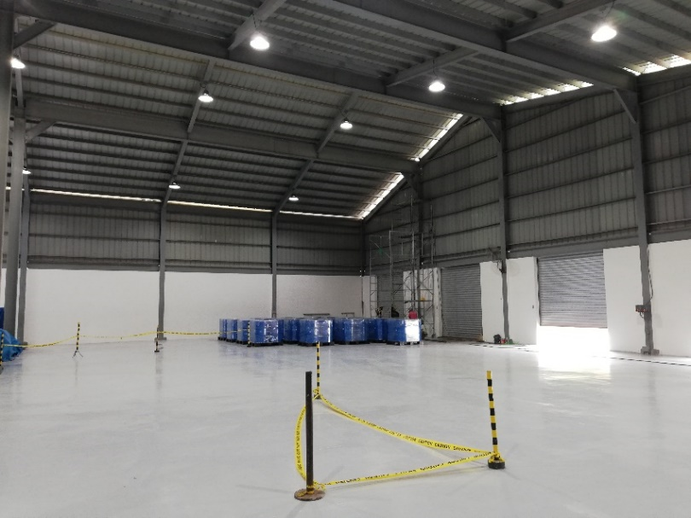
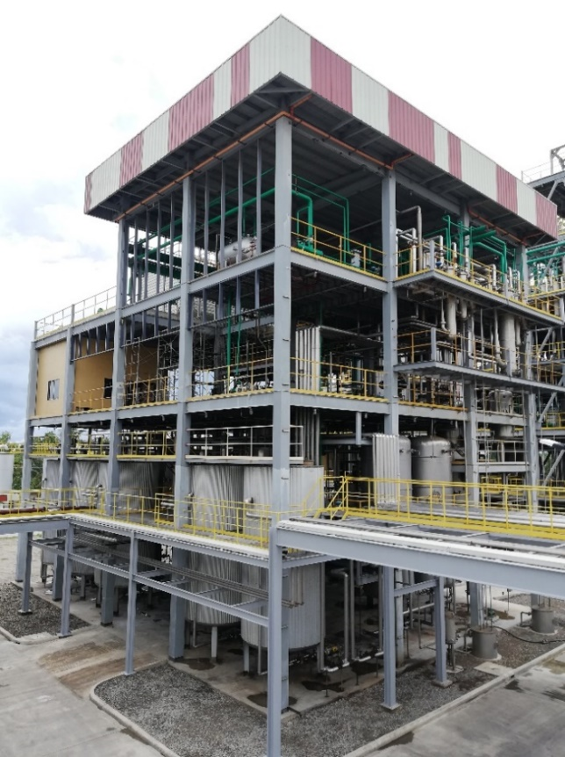
Previous Projects
Asian Power Construction provides high quality technical solutions reached the requirements of the Projects.
PRODUCT WAREHOUSE - ALL NATURAL COCO PRODUCTS
Location: ANC Compound Bacong, Negros Oriental
Project Duration:
Scope of Works:
Civil and Structural Construction
Warehouse Interiors and Finishing
MEP Works (Mechanical, Electrical, Plumbing)
Racking Systems and Material Handling
PIPING OF MCT & FATTY ACID BLDG. - ALL NATURAL COCO PRODUCTS
Location: ANC Compound Bacong, Negros Oriental
Project Duration:
Scope of Works:
Shop Drawing and Material Submittals
Supply and Fabrication of Piping Materials
Piping Installation
Valve and Instrument Integration
Pressure Testing and Commissioning.

Slide 9
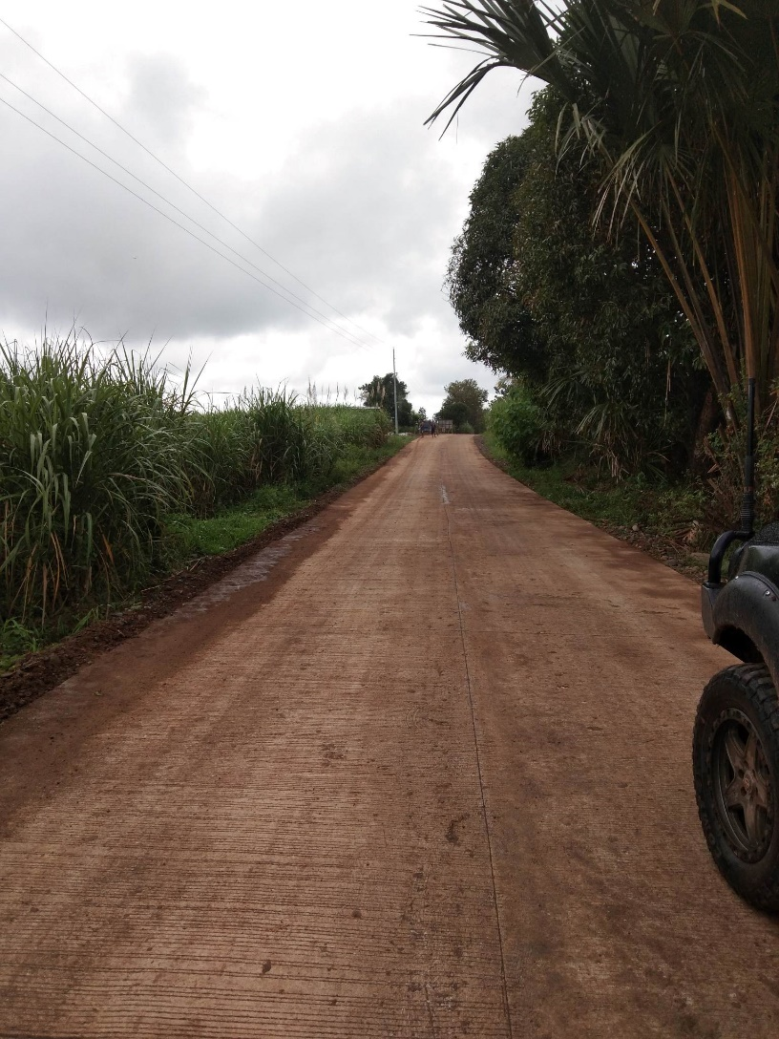
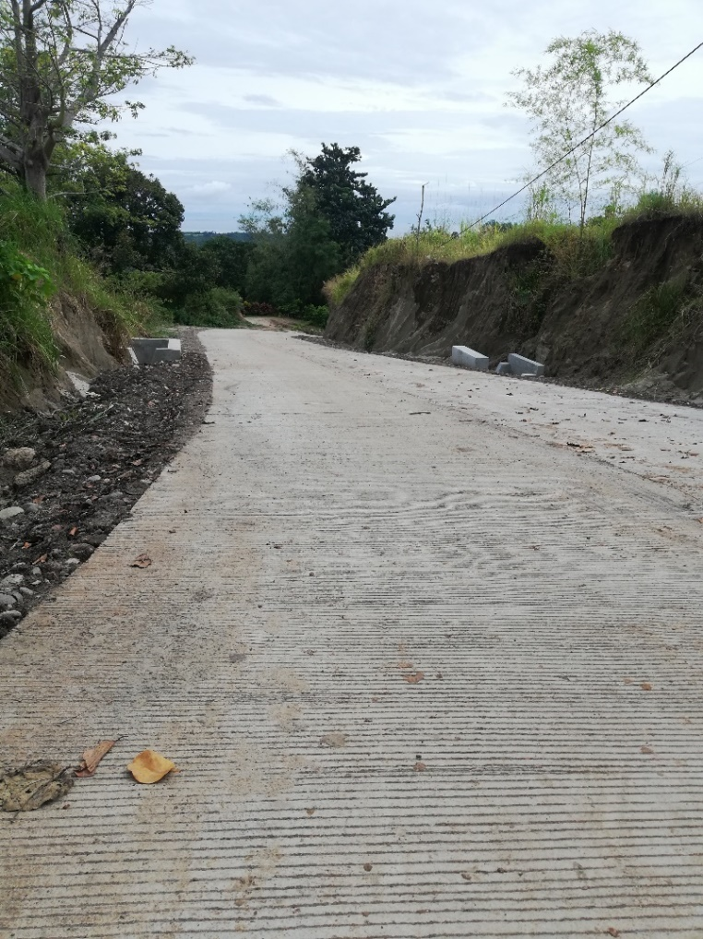
Previous Projects
Asian Power Construction provides high quality technical solutions reached the requirements of the Projects.
DSWD-CONCRETING OF ROAD
Location: Casalaan Siaton, Negros Oriental
Project Duration:
Scope of Works:
Site Clearing and Excavation
Subgrade Preparation and Compaction
Formwork and Reinforcement Installation
Concrete Placement and Finishing
Curing and Joint Cutting
DSWD-CONCRETING OF ROAD
Location: Caticugan Siaton, Negros Oriental
Project Duration:
Scope of Works:
Site Clearing and Excavation
Subgrade Preparation and Compaction
Formwork and Reinforcement Installation
Concrete Placement and Finishing
Curing and Joint Cutting

Slide 10
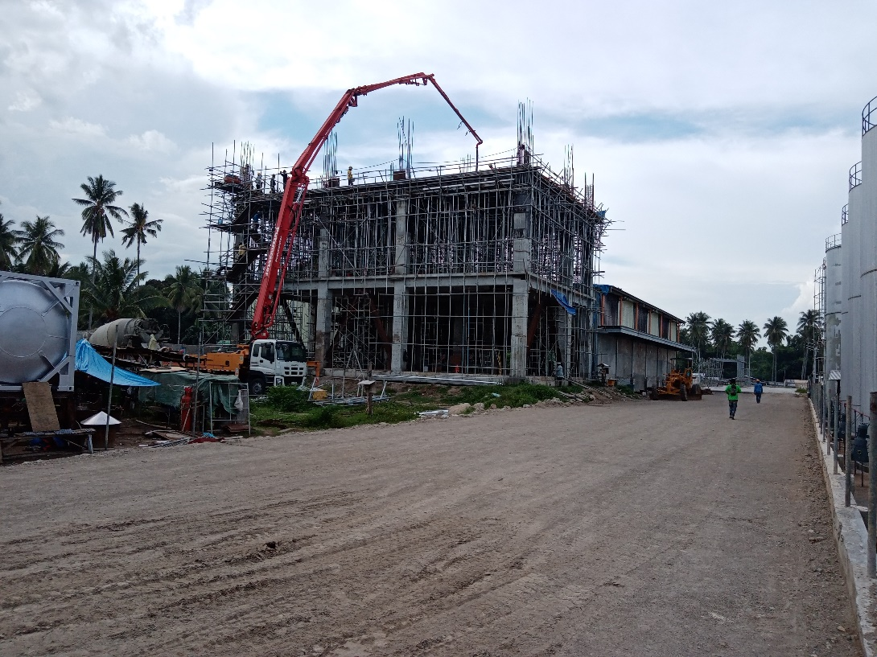
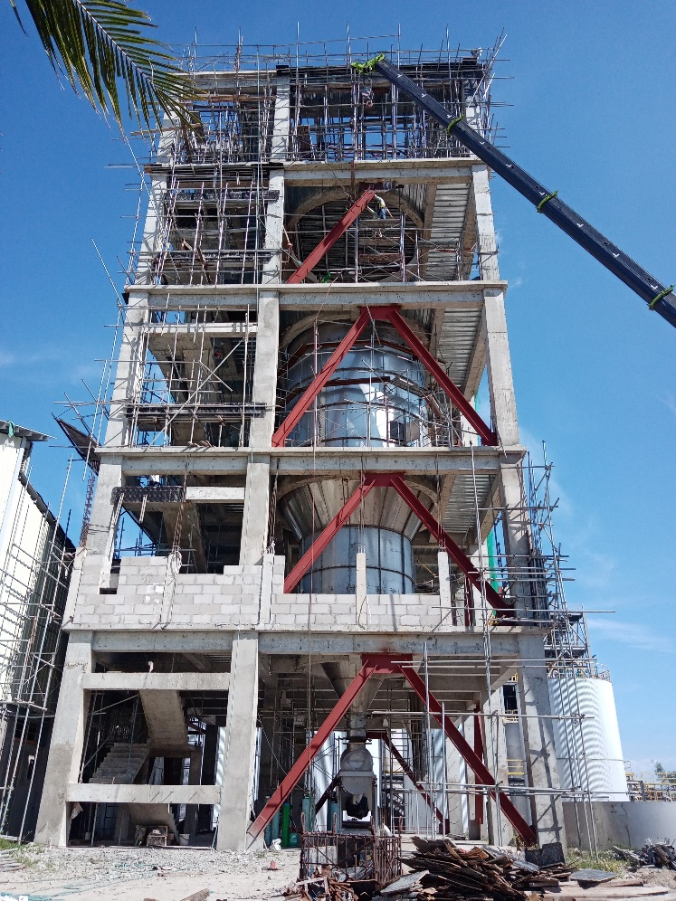
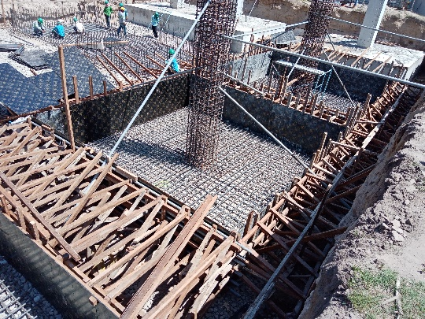
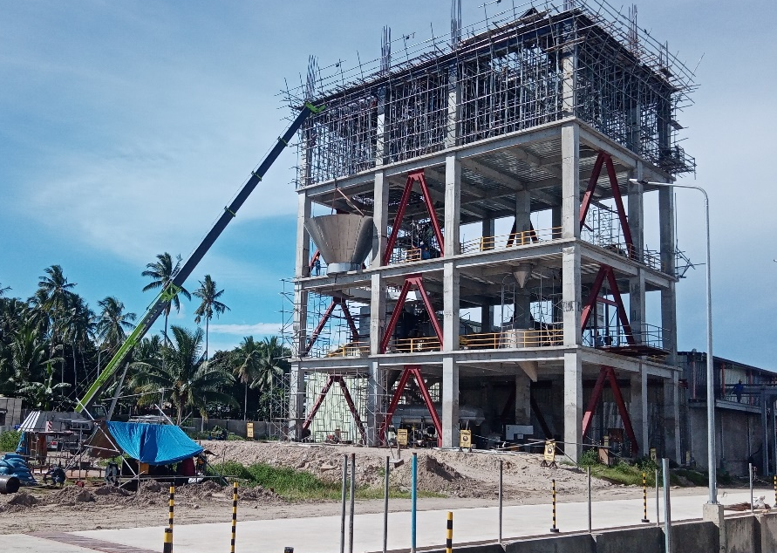
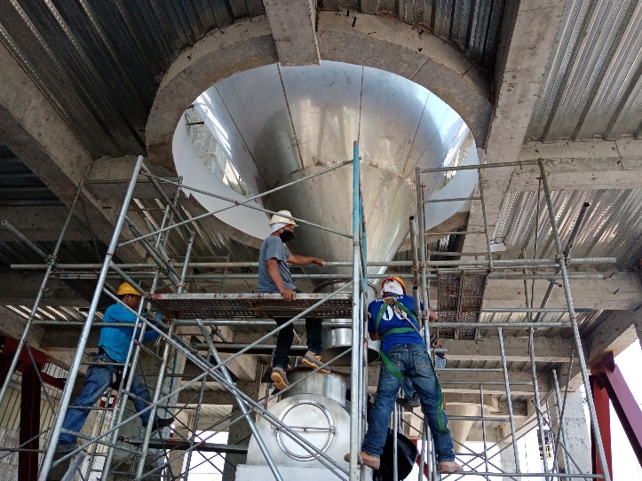
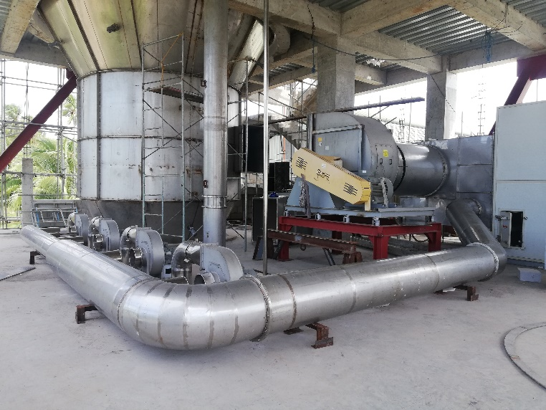
Previous Projects
Asian Power Construction provides high quality technical solutions reached the requirements of the Projects.
PRILLING TOWER – ALL NATURAL COCO PRODUCTS Civil Works
Location: ANC Compound Bacong, Negros Oriental
Project Duration:
Scope of Works:
Site Preparation and Earthworks
Foundation Works
Structural Concrete Works
Structural Steel Erection
Drainage Systems
PRILLING TOWER – ALL NATURAL COCO
PRODUCTS Mechanical Works
Location: ANC Compound Bacong, Negros Oriental
Project Duration:
Scope of Works:
Installation of Prilling Equipment
Material Handling Systems
Air Handling and
Ventilation Systems
Piping and Pumping Systems

Slide 11
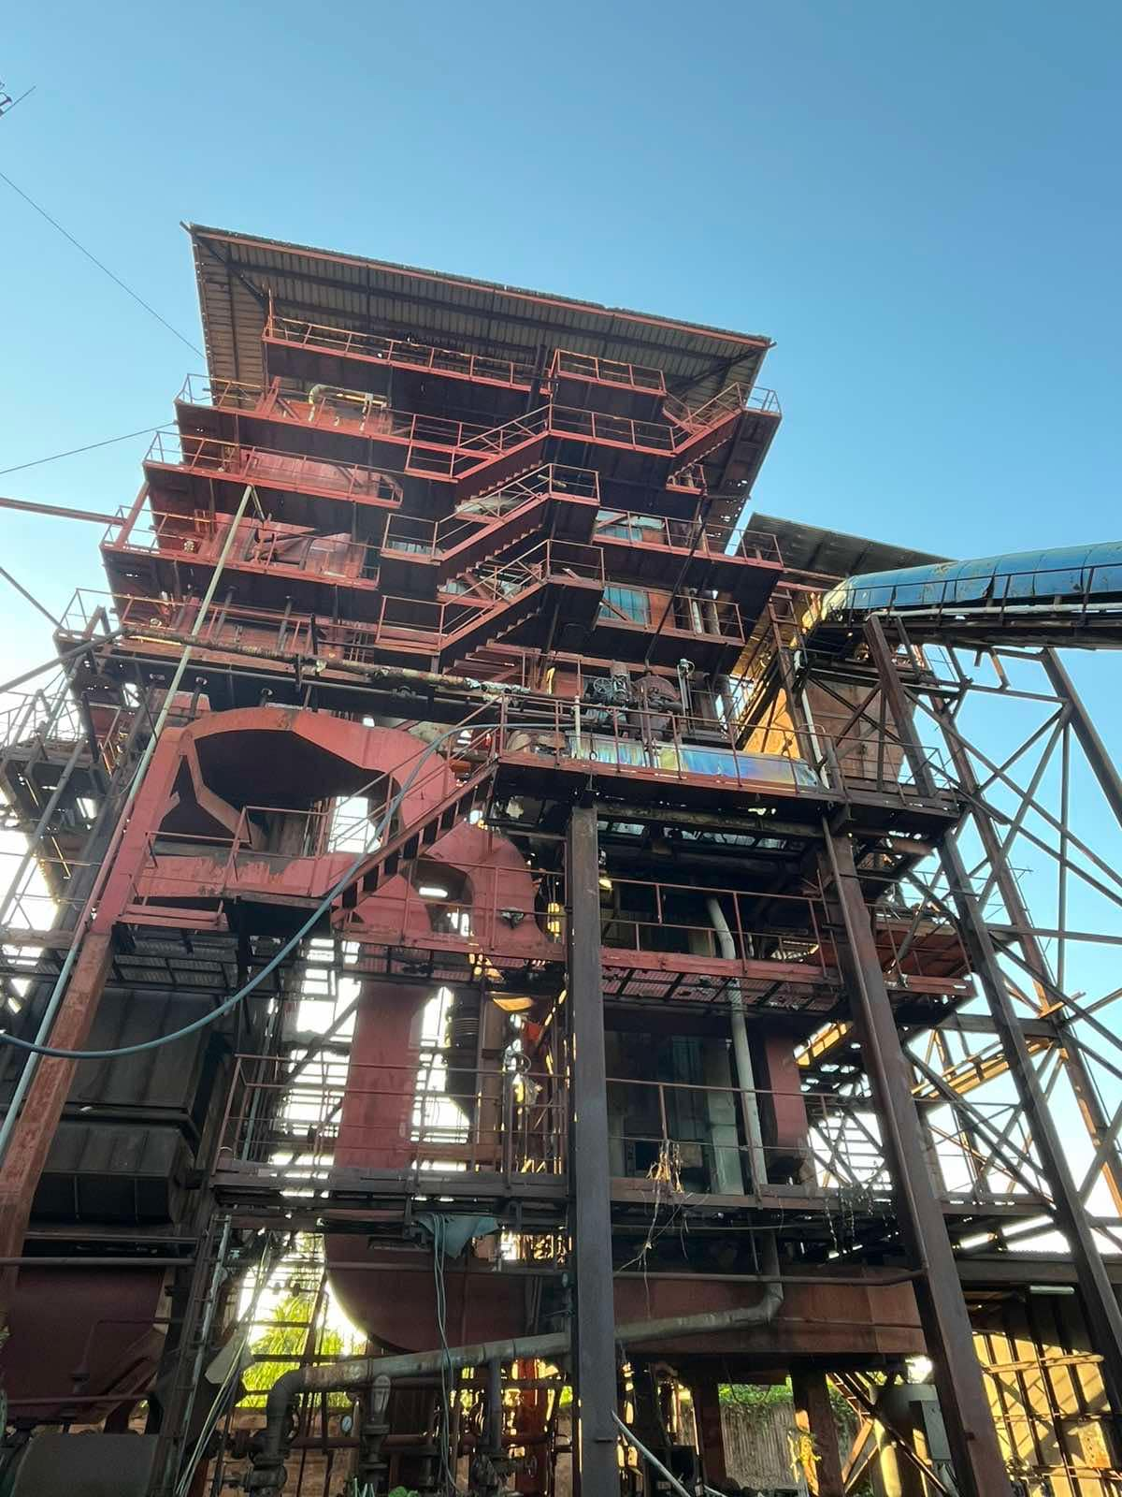
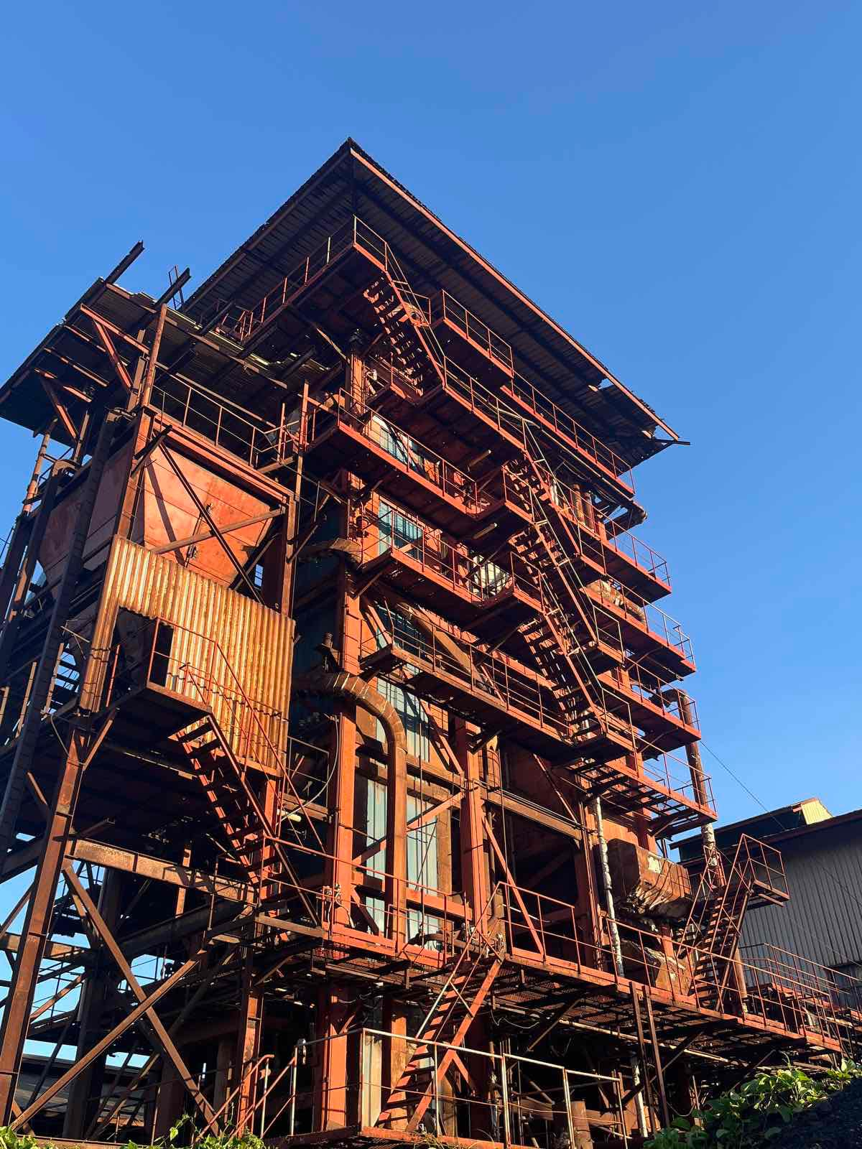
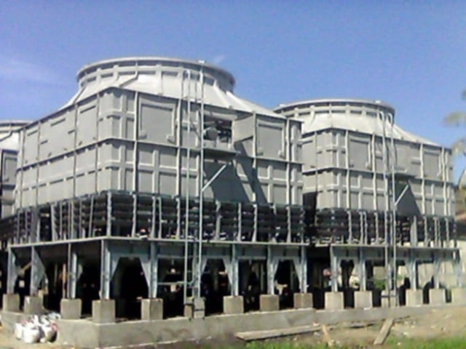
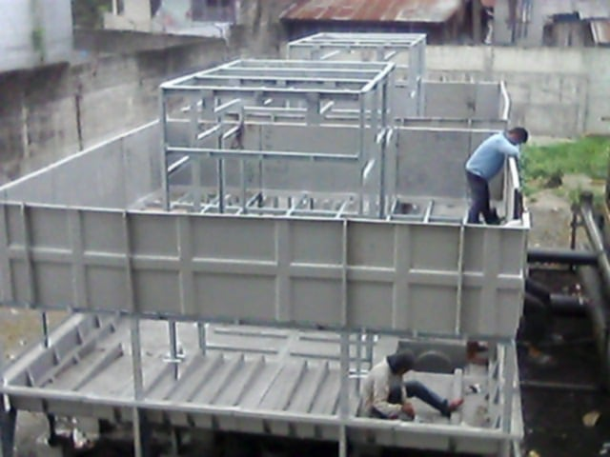
Previous Projects
Asian Power Construction provides high quality technical solutions reached the requirements of the Projects.
CIRCULATING FLUIDIZED
BED BOILER - PHIDCO 3MW Power Plant
Location: Zamboanga City
Project Duration:
Scope of Works:
Foundation and Structural Works
Boiler Assembly and Installation
Piping and Boiler Feedwater Systems
Mechanical and Electrical Systems
COOLING TOWER - PHIDCO
Location: Zamboanga City
Project Duration:
Scope of Works:
Site Preparation and Foundation Works
Cooling Tower Structure Erection
Water Distribution and Piping Systems
Mechanical and Electrical Systems

Slide 12
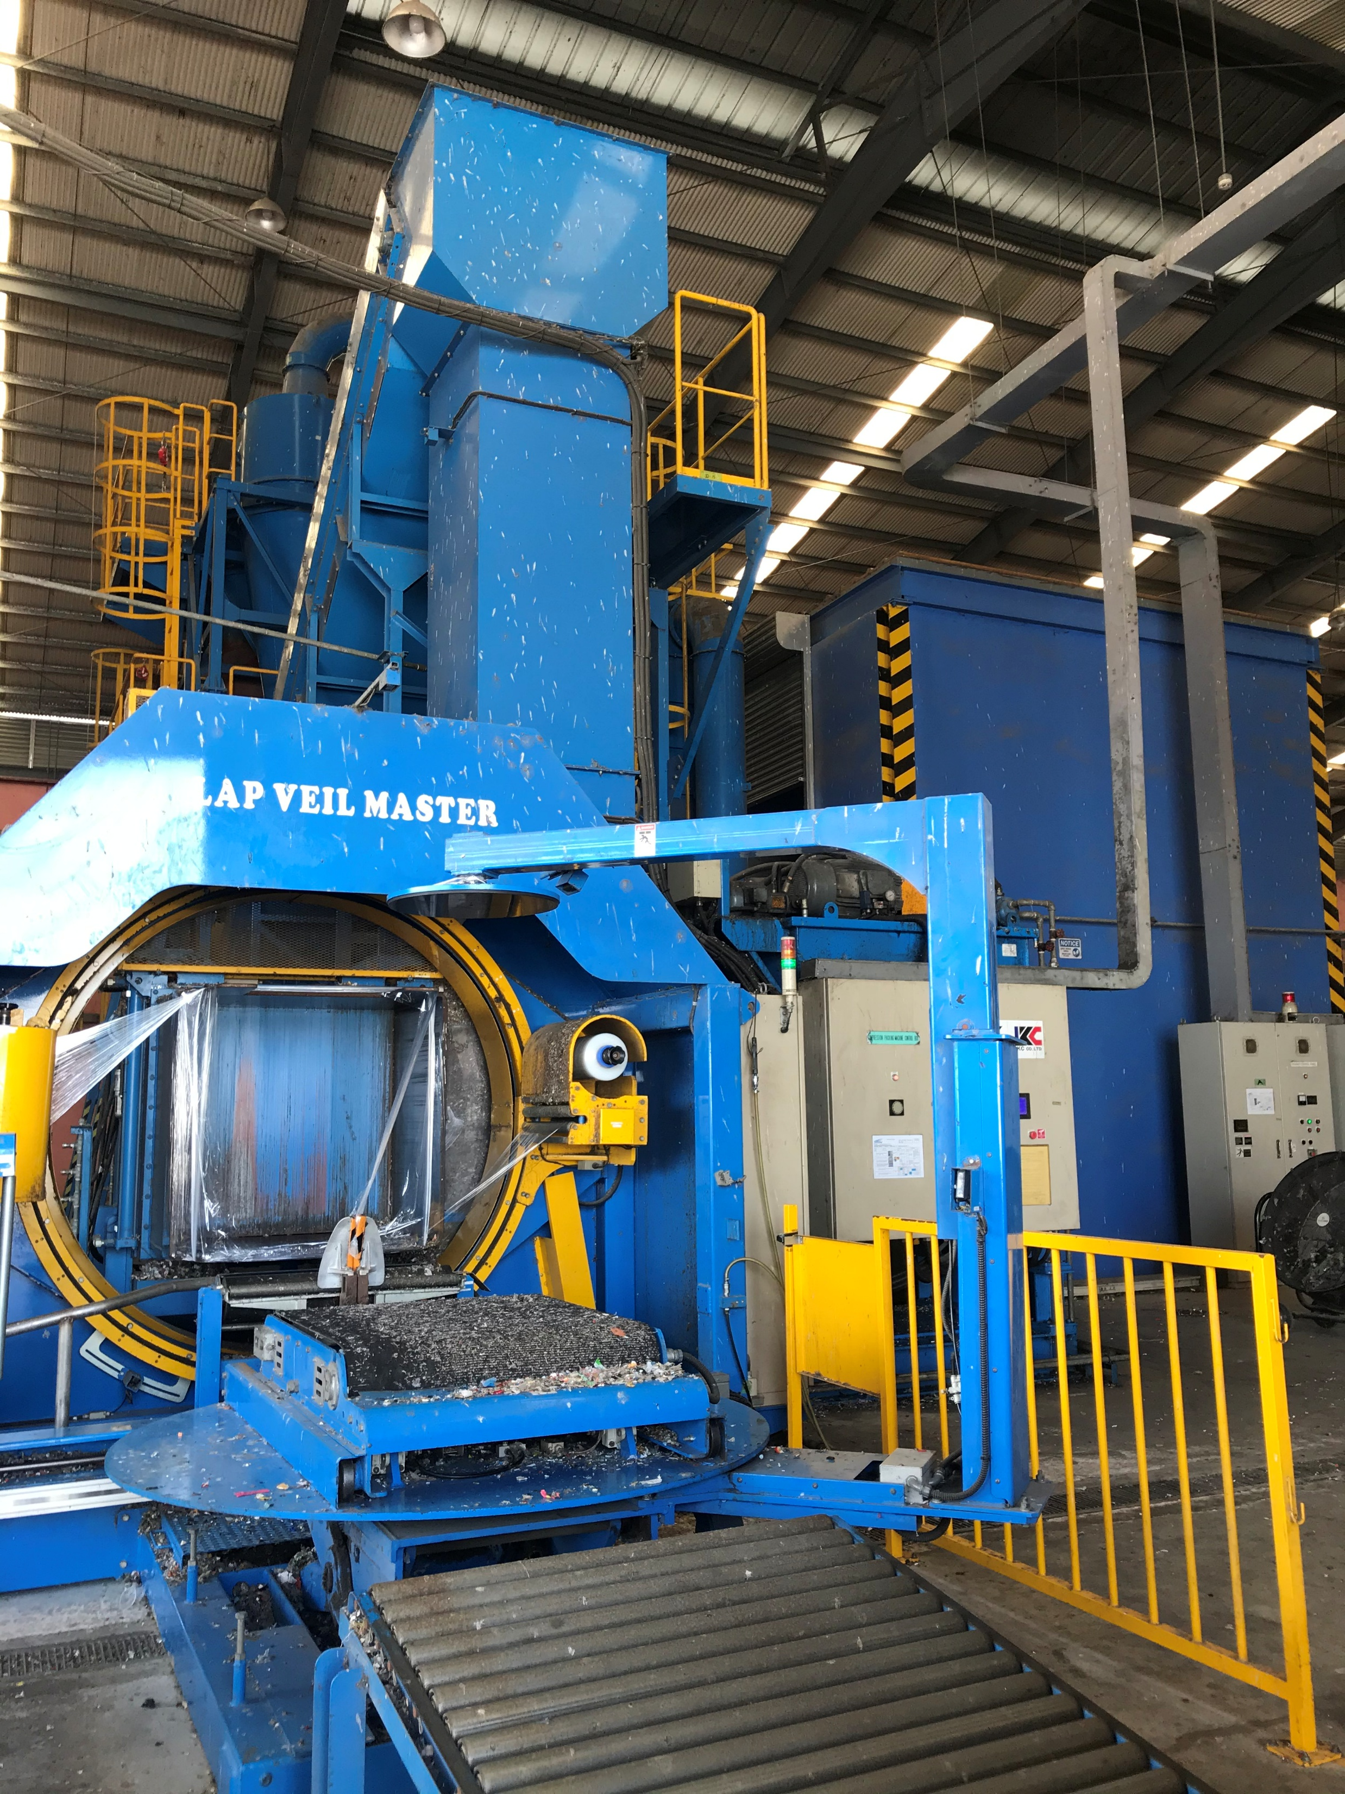
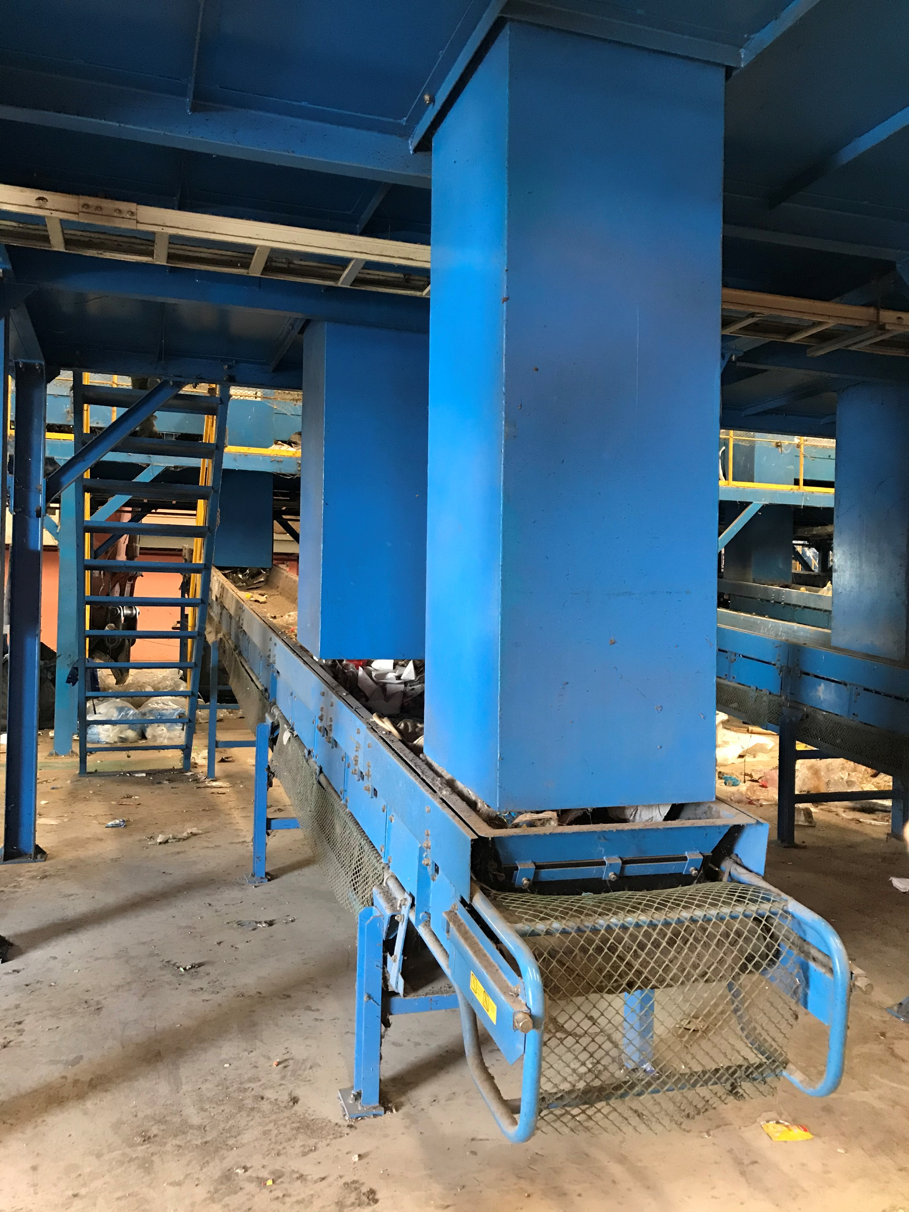
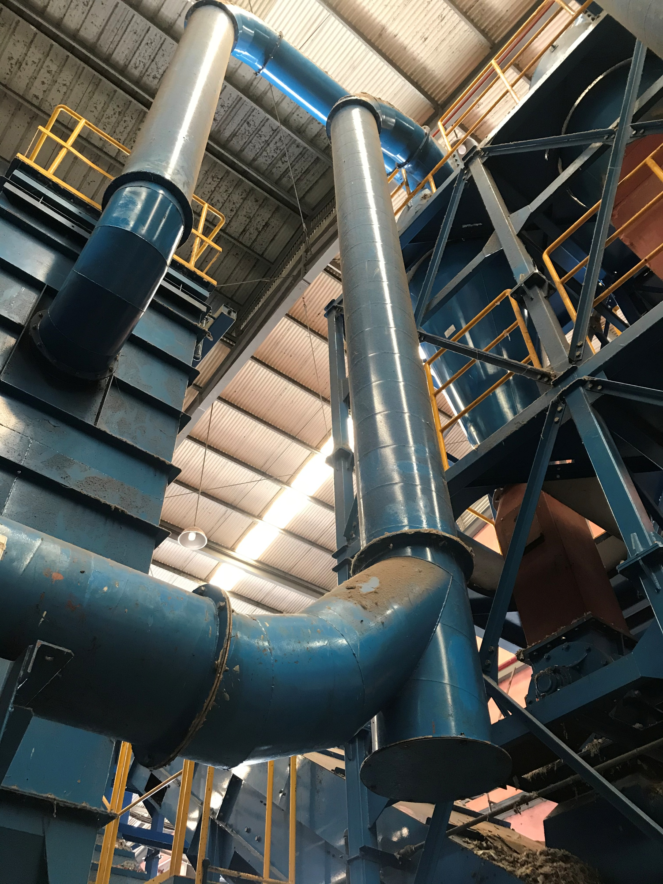
Previous Projects
Asian Power Construction provides high quality technical solutions reached the requirements of the Projects.
MODIFICATION OF EXISTING PLASTIC WASTE FACILITY - GUUN CO., LTD. – PHILIPPINE BRANCH
Location: Consolacion, Cebu City
Project Duration: Sep. 21- Oct. 19, 2021
Scope of Works:
Modification and replacement of belts and conveyor
Mechanical and Electrical Systems
Improvement of Plant Process and Plant Layout
Testing, Commissioning, and Turnover

Slide 13

We are easy to find.
Let us know your needs
Address: Main Office Zamboanga City, San Jose Panigayan #0917 303 5003

